Slide 1
Introduction to AI Agent protocols
Discover how modern AI systems communicate and interact with the external world

Slide 2
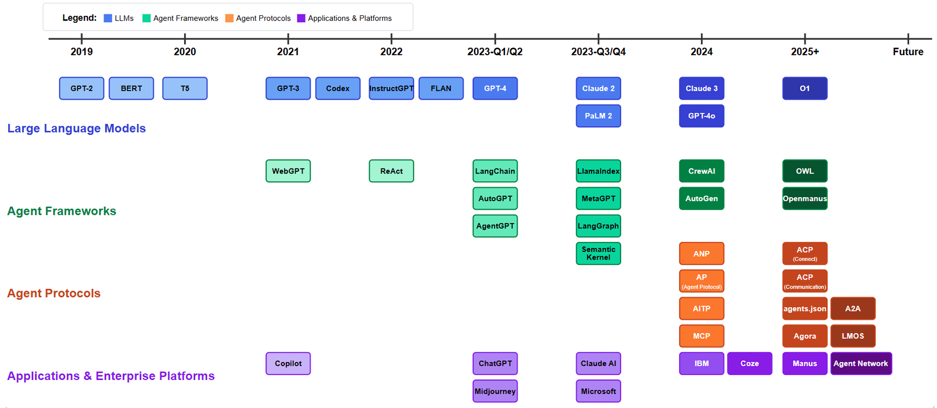
AI Domain Development TimeLine
2504.16736

Slide 3
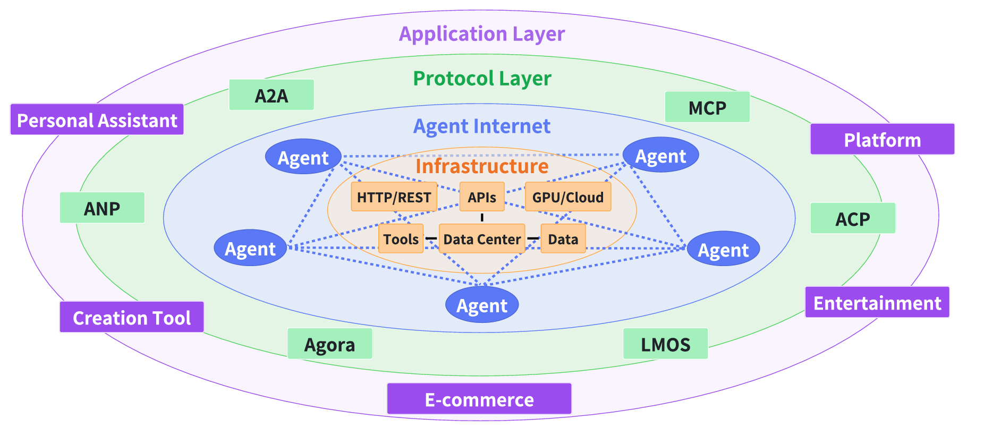
Agent Internet Ecosystem
You've likely used AI systems like ChatGPT, Gemini or Claude, but have you ever wondered why they're limited to just conversation or may be image generation? Why can't they take meaningful actions in the real world?
The fundamental limitation of traditional Large Language Models (LLMs) has been their inability to interact with the outside world - they can generate impressive text or image but can't directly impact their environment.
A layered architecture of the Agent Internet Ecosystem
While LLMs primarily focus on text generation based on input prompts, agents are designed to function autonomously within real-world environments.
In response to the rapidly evolving demands of LLM agents, a variety of agent protocols have emerged.
2504.16736
Why This Matters
These protocols aren't just technical specifications—they're the foundation of a new era in AI capability. As they mature and become widely adopted, we'll see AI systems that can seamlessly integrate with our digital infrastructure, access the information they need, and collaborate with specialized systems to accomplish complex tasks that no single AI could handle alone.

Slide 4
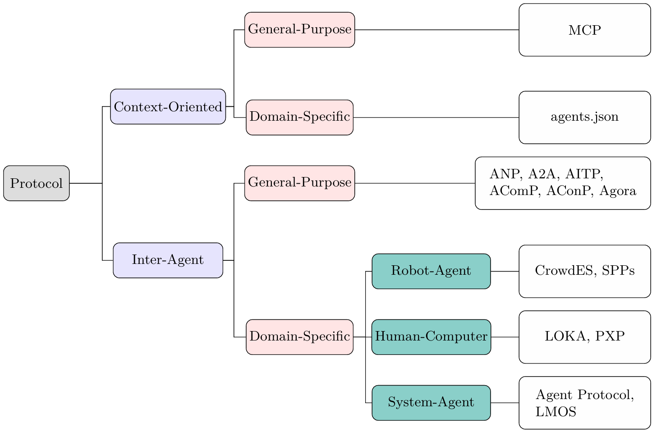
Classification of various agent protocols
Protocols can be grouped in two ways:
First, based on their focus—either on the context they operate in (context-oriented) or on communication between agents (inter-agent).
Second, based on how they are used—either for general purposes or tailored for specific domains.
Most protocols aim to enable agents to:
Discover other agents
Authenticate
Communicate
Form coalitions
Negotiate and debate
Create autonomous software
The exception is MCP, which doesn't necessarily prioritize agent-to-agent communication.

Slide 5
How AI Gets Its Superpowers
Among the various emerging protocols, the major three are:
Function Calling (Interaction)
Teaching AI to use tools - Enabling models to recognize when to use external tools and APIs, and how to structure the necessary parameters.
MCP - Model Context Protocol (Data Access)
Connecting AI to data sources - Standardizing how AI systems access and interact with information repositories and external knowledge.
A2A - Agent-to-Agent (Collaboration)
Enabling AI collaboration - Creating a standardized way for different AI systems to communicate and work together regardless of their underlying frameworks.
These protocols represent the critical evolution from isolated models to interconnected, capable assistants that can understand, access information, and collaborate to solve complex problems.
Why This Matters
Through these three technologies, AI systems are evolving from mere "smart chatbots" into genuine digital assistants capable of taking meaningful action in the world.

Slide 6
Quick Comparison: Function Calling vs MCP vs A2A
 | Function Calling | MCP | A2A
What it solves | Model → API calls | Model → Tools access, standardized | Agent → Agent collaboration
Good for | Simple real-time queries | Scalable tool ecosystems | Distributed multi-agent workflows
Pain points | No standard, messy multi-model support | Need to set up servers | Still early days, limited support
Real-world analogy | Teaching your AI to make phone calls | Having any smart app access any database/API easily | Having teams of bots working together like coworkers
Function Calling vs. MCP vs. A2A: Developer’s Guide to AI Agent Protocols - Zilliz blog

Slide 7
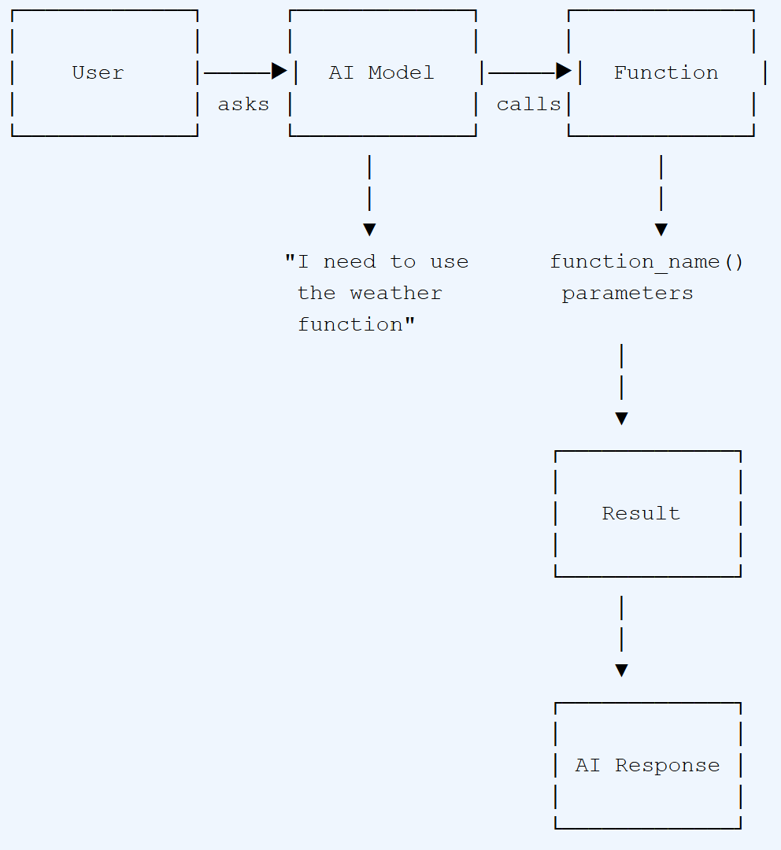
Function Calling: Giving AI Tools to Work With
Function calling is the ability for an AI model to recognize when it needs to use an external tool or API, and to generate the proper structured arguments for that function call. It's essentially teaching AI when and how to use tools to accomplish tasks beyond simple text generation.
Analogy: The New Intern
Imagine you've hired a new intern at your office. You've shown them all the available tools - Excel for spreadsheets, Email for communication, the printer for documents, etc. Now, whenever a task comes up, the intern decides which tool is appropriate. If they need to create a report, they use Excel. If they need to send a message, they use Email.
Similarly, with function calling, you tell the AI what functions are available (along with their descriptions and required parameters), and the AI decides when to use them and with what parameters based on the user's request.
How Function Calling Works
Define Functions: Developers define available functions with their names, descriptions, and required parameters.
User Input: A user asks a question like "What's the weather in London?"
AI Analysis: The AI recognizes this requires external data and determines the weather function is appropriate.
Parameter Generation: The AI structures the necessary parameters (location="London").
Function Execution: Your system executes the function (calls the weather API).
Response Integration: The AI incorporates the result into a natural, conversational response.
Function calling was first introduced by OpenAI in June 2023. Since then, it has been widely adopted across the industry and has become a fundamental capability in modern AI systems.

Slide 8
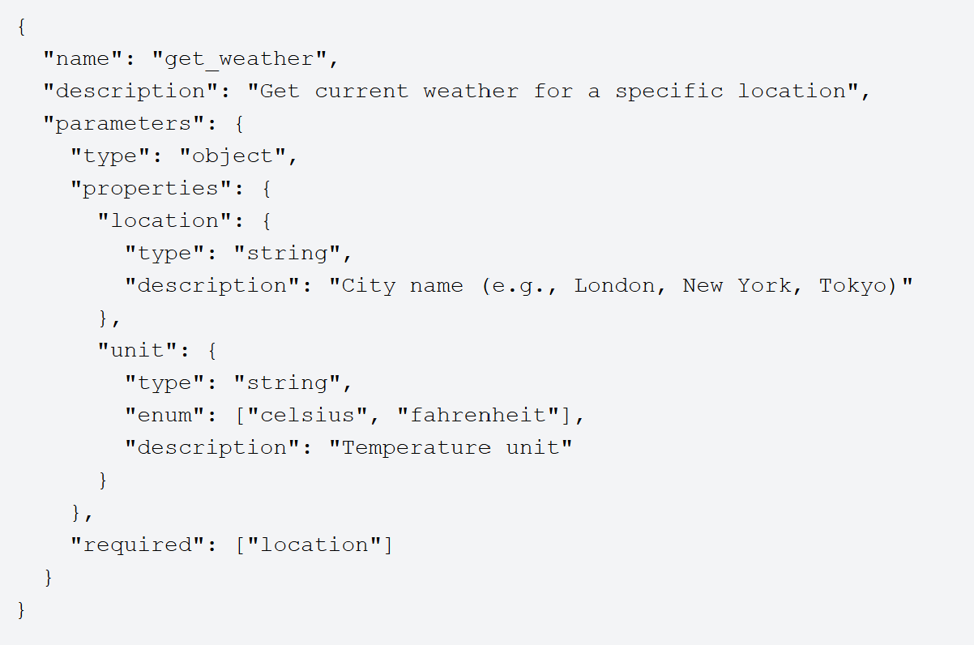
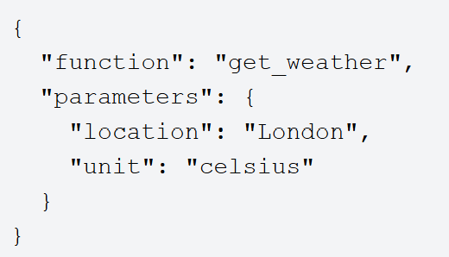
Function Calling: Technical Implementation
Functions are defined in JSON Schema format, providing the AI with a clear structure of available tools:
When the AI determines a function call is needed, it generates a structured output like this:

Slide 9
Function Calling: Real-World Applications
Information Retrieval: Product Information and Comparison in Banking
Scenario: A customer on a bank's website or mobile app asks a chatbot, "Compare the features of the 'Platinum Rewards Credit Card' with the 'Premium Travel Credit Card' and show me customer ratings for both."
Function Calling for : The chatbot initiates multiple function calls to the bank's product database and customer feedback system:
get_credit_card_details(card_id='Platinum_Rewards_Credit_Card_ID')
get_credit_card_details(card_id='Premium_Travel_Credit_Card_ID')
get_customer_product_ratings(product_id='Platinum_Rewards_Credit_Card_ID', num_ratings=5)
get_customer_product_ratings(product_id='Premium_Travel_Credit_Card_ID', num_ratings=5)
Information Retrieved: Detailed specifications for both credit cards (e.g., annual fees, interest rates, reward points structure, travel benefits, foreign transaction fees), and the latest customer ratings or aggregated sentiment scores for each card.
Application: The chatbot presents a structured comparison of the credit card features and summarizes customer feedback, empowering the customer to make an informed decision about which banking product best suits their needs.
Customer Service: Loan Application Assistance
Scenario: A customer interacts with an AI assistant to inquire about loan eligibility or initiate a loan application.
Function Calling: The AI, based on the conversation, can trigger function calls to:
check_customer_credit_score(customer_id): Access an internal or external credit scoring system to get the customer's creditworthiness.
retrieve_loan_product_details(loan_type, customer_segment): Fetch specific details (interest rates, terms, eligibility criteria) for various loan products relevant to the customer's profile.
initiate_loan_application_form(customer_id, loan_type, prefilled_data): Start a digital loan application process, pre-filling known customer information to simplify the user experience.
schedule_call_with_loan_officer(customer_id, preferred_time): If the AI cannot fully assist, it can call a function to integrate with the bank's CRM or scheduling system to book a call with a human loan officer.
Benefit: Speeds up the loan application process, provides accurate and immediate information to customers, and reduces the workload on human customer service representatives.

Slide 10
Function Calling: Advantages and Limitations
Advantages
Easy implementation: Simple to set up with most AI APIs
Direct integration: Works within existing LLM frameworks
Flexibility: Can connect to virtually any API or service
Structured output: Guarantees valid parameter formats
Rapid adoption: Widely supported across major AI providers
Limitations
Tight coupling: Function logic embedded in AI reasoning
Limited interoperability: Not standardized across systems
Scaling challenges: Complex with many functions
Vendor dependence: Implementation varies by AI provider
Limited context: Functions may lack broader system awareness

Slide 11
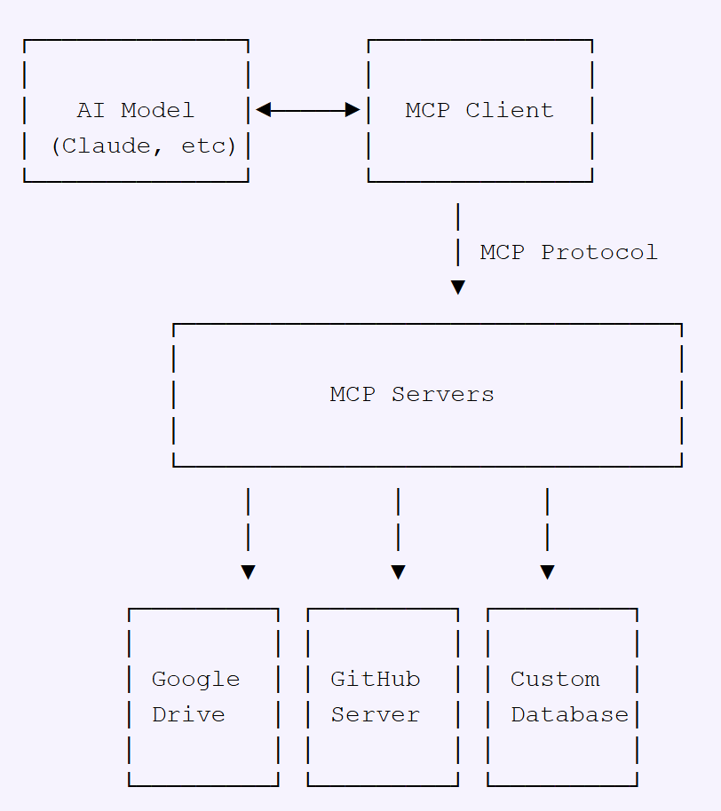
Model Context Protocol (MCP): The Universal Data Connector
The Model Context Protocol (MCP) is an open standard designed to connect AI systems with various data sources in a standardized way. Developed by Anthropic in November 2024, MCP creates a universal interface for AI systems to access content repositories, business tools, and development environments without custom integrations for each source.
Analogy: The Universal Port
Think of MCP as the USB-C port of the AI world. Just as your laptop can connect to any device—monitors, hard drives, phones—through a single standardized USB-C port, MCP allows AI systems to connect to any data source—Google Drive, GitHub, databases, etc.—through a single standardized protocol.
This standardization eliminates the need for custom integrations with each data source, dramatically simplifying how AI systems access and interact with external information.
How MCP Works
MCP Architecture:
MCP Hosts: Applications like Claude Desktop or AI tools that need to access external data
MCP Clients: Protocol clients that maintain connections with MCP servers
MCP Servers: Lightweight programs that expose specific capabilities through the MCP protocol
Data Sources: Local files, databases, or remote services that MCP servers connect to
The Model Context Protocol was launched by Anthropic in November 2024. It represents a shift from the ad-hoc integrations of early AI systems toward a more structured, interoperable approach to AI-data connectivity.

Slide 12
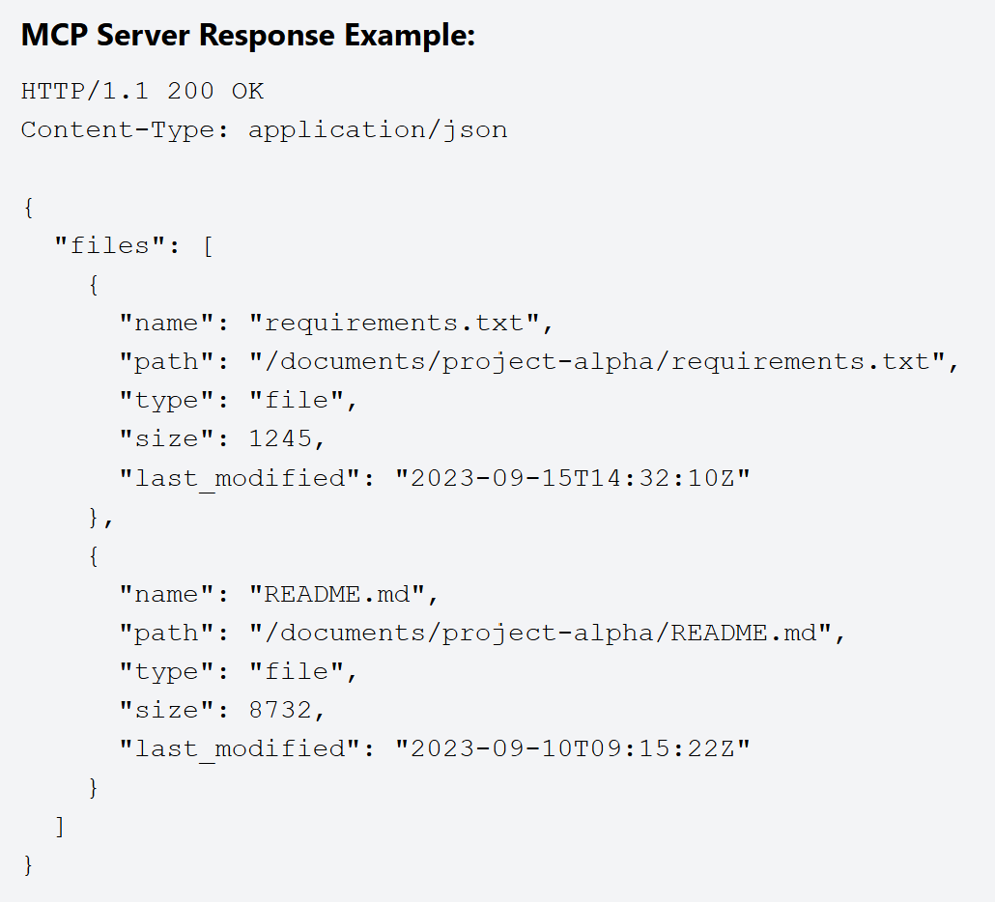
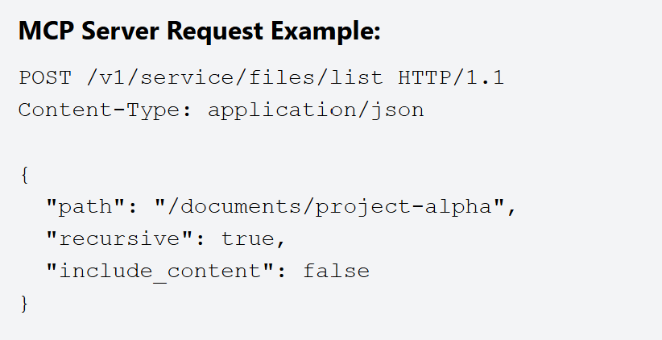
MCP: Technical Implementation
The communication between MCP servers and clients follows a standardized HTTP-based protocol. Here's how it works in practice:
The MCP ecosystem is growing rapidly with pre-built servers already available for many popular services including GitHub, Git, and Postgres. Major companies like Block and Apollo have already integrated MCP into their systems, demonstrating its enterprise readiness.

Slide 13
MCP: Real-World Applications
Fraud Detection
Scenario: A customer initiates an online transaction or makes a purchase using their debit/credit card.
MCP for: Real-time, context-aware fraud detection.
Application:
Contextual Data: The MCP gathers and processes various contextual data points relevant to the transaction, which a fraud detection model uses. This typically includes:
Geospatial context: Transaction location vs. customer's typical location or reported travel plans.
Time context: Time of day/week for the transaction compared to usual activity.
Behavioral context: Transaction amount, merchant category, frequency of transactions compared to the customer's historical patterns.
Device context: IP address, device ID, browser fingerprint if the transaction is online.
Account status context: Any recent suspicious activity on the account, balance available.
Authentication context: How the transaction was authenticated (e.g., 3D Secure, biometrics).
Model Interaction: A fraud detection model, leveraging the MCP, analyzes these contextual cues in real-time. If the aggregated context suggests a high probability of fraud (e.g., a large transaction from an unusual location on an unknown device at an odd hour, without prior travel notification), the model triggers an alert or declines the transaction.
Benefit:
Reduced Financial Losses: Minimizes losses from fraudulent transactions for both the bank and its customers.
Enhanced Security & Trust: Proactive fraud prevention builds customer confidence and protects their assets.
Fewer False Declines: By incorporating more context, the system can distinguish between genuinely fraudulent activity and unusual but legitimate transactions (e.g., a customer traveling and using their card), leading to a better customer experience.
Personalized Financial Product Recommendations
Scenario: A bank wants to offer relevant financial products (e.g., loans, credit cards, investment opportunities) to its customers.
MCP for: Delivering highly targeted and personalized product recommendations.
Application:
Contextual Data: The MCP compiles a comprehensive profile of the customer using various data points:
Account history: Savings balance, checking account activity, existing loans, credit card usage.
Demographic information: Age, income bracket, marital status, family size.
Life events (inferred or provided): Recent major purchases (e.g., car loan, home mortgage applications suggesting life changes like buying a house).
Digital interactions: What sections of the bank's website or app do they visit? Which product pages do they browse? What emails do they open?
Risk profile: Based on credit score and financial behavior.
Market conditions: Interest rates, economic outlook, specific product promotions.
Customer inquiries: Recent calls to customer service about specific product types.
Model Interaction: A recommendation engine model, powered by the MCP's insights, analyzes this context to understand the customer's current financial situation, needs, and potential future requirements. It then recommends suitable products, potentially even pre-qualifying them.
Benefit:
Increased Cross-selling & Upselling: More relevant offers lead to higher acceptance rates for new products.
Improved Customer Satisfaction: Customers receive offers that genuinely meet their needs, rather than generic spam, enhancing their relationship with the bank.
Optimized Marketing Spend: By targeting the right customers with the right products, marketing efforts become more efficient.

Slide 14
MCP: Advantages and Limitations
Advantages
Clean separation: Decouples AI models from data sources
Standardized protocol: Ensures consistent data exchange patterns
Universal connectivity: One protocol for multiple data sources
Enhanced security: Data remains within controlled infrastructure
Vendor flexibility: Switch between AI providers without changing data access
Privacy-preserving: Minimizes data exposure to external systems
Limitations
Primarily data-focused: Better for data access than complex interactions
Emerging ecosystem: Still developing comprehensive tooling
Implementation complexity: Requires more setup than simple function calling
Learning curve: New paradigm for many developers
Adoption challenges: Requires ecosystem buy-in to reach full potential

Slide 15
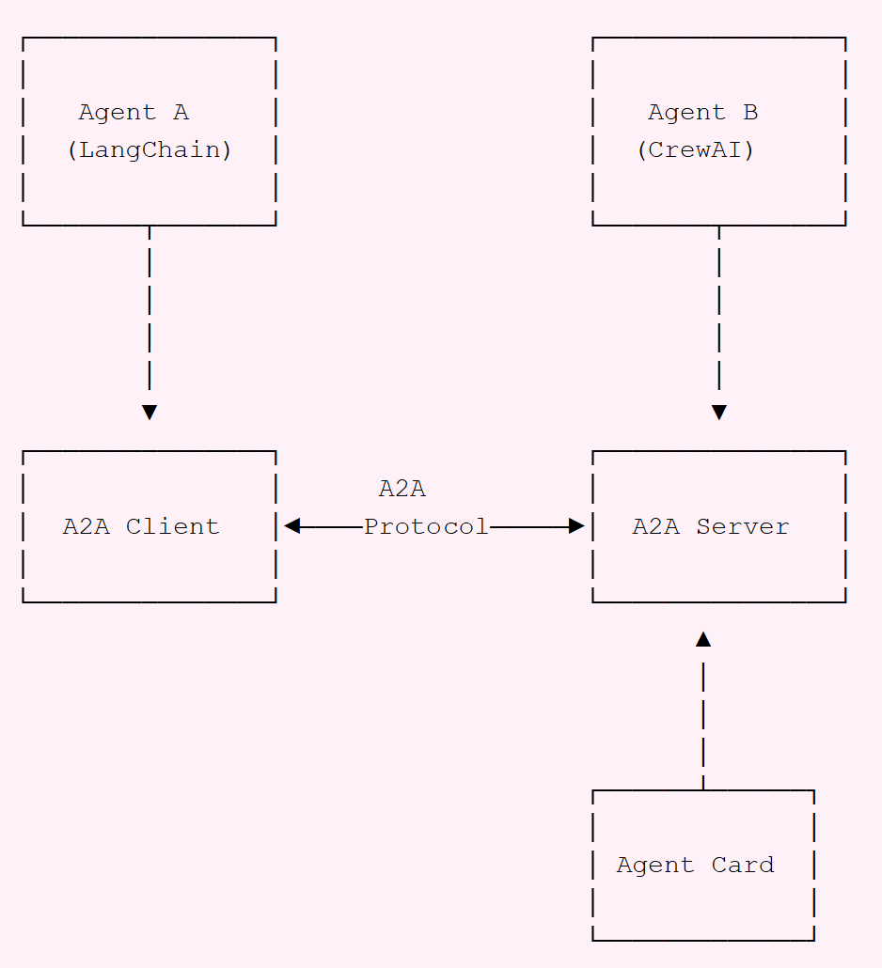
Agent-to-Agent (A2A): Enabling AI Collaboration
The Agent-to-Agent (A2A) protocol is an open standard developed by Google in April 2025 that enables communication between different AI agents, regardless of which framework or vendor created them. A2A facilitates secure, standardized communication between independent AI systems, allowing them to collaborate on complex tasks.
Analogy: The Universal Phone Network
Think of A2A as the cellular network of the AI world. Just as phones from different manufacturers—iPhones, Samsung, Xiaomi—can all communicate with each other through a standardized cellular protocol, A2A allows AI agents built by different companies and frameworks to seamlessly communicate with one another.
This universal communication layer means that specialized AI agents can work together regardless of who built them or what underlying technology they use. Just as you don't need to worry about whether your friend has the same phone brand when calling them, with A2A, AI systems don't need to be built on the same framework to collaborate effectively.
How A2A Works
Agent Cards: Public metadata files that describe an agent's capabilities, skills, and endpoint URL, enabling discovery and interaction
A2A Server: An agent that implements the A2A protocol methods and can receive and process requests from other agents
A2A Client: An application or agent that consumes A2A services by sending requests to A2A servers
Tasks: Work units that progress through different states (submitted, working, completed, etc.) as they're processed by agents
Messages: Communication turns containing various content types including text, structured data, forms, and media
A2A protocol is already supported by major AI frameworks including LangGraph, CrewAI, Semantic Kernel, Marvin, Genkit, and LlamaIndex. This widespread adoption makes it easier for developers to build interoperable multi-agent systems without worrying about compatibility issues.
As the protocol continues to mature, we can expect to see even more frameworks and platforms adding A2A support, further expanding the ecosystem of collaborative AI agents.

Slide 16
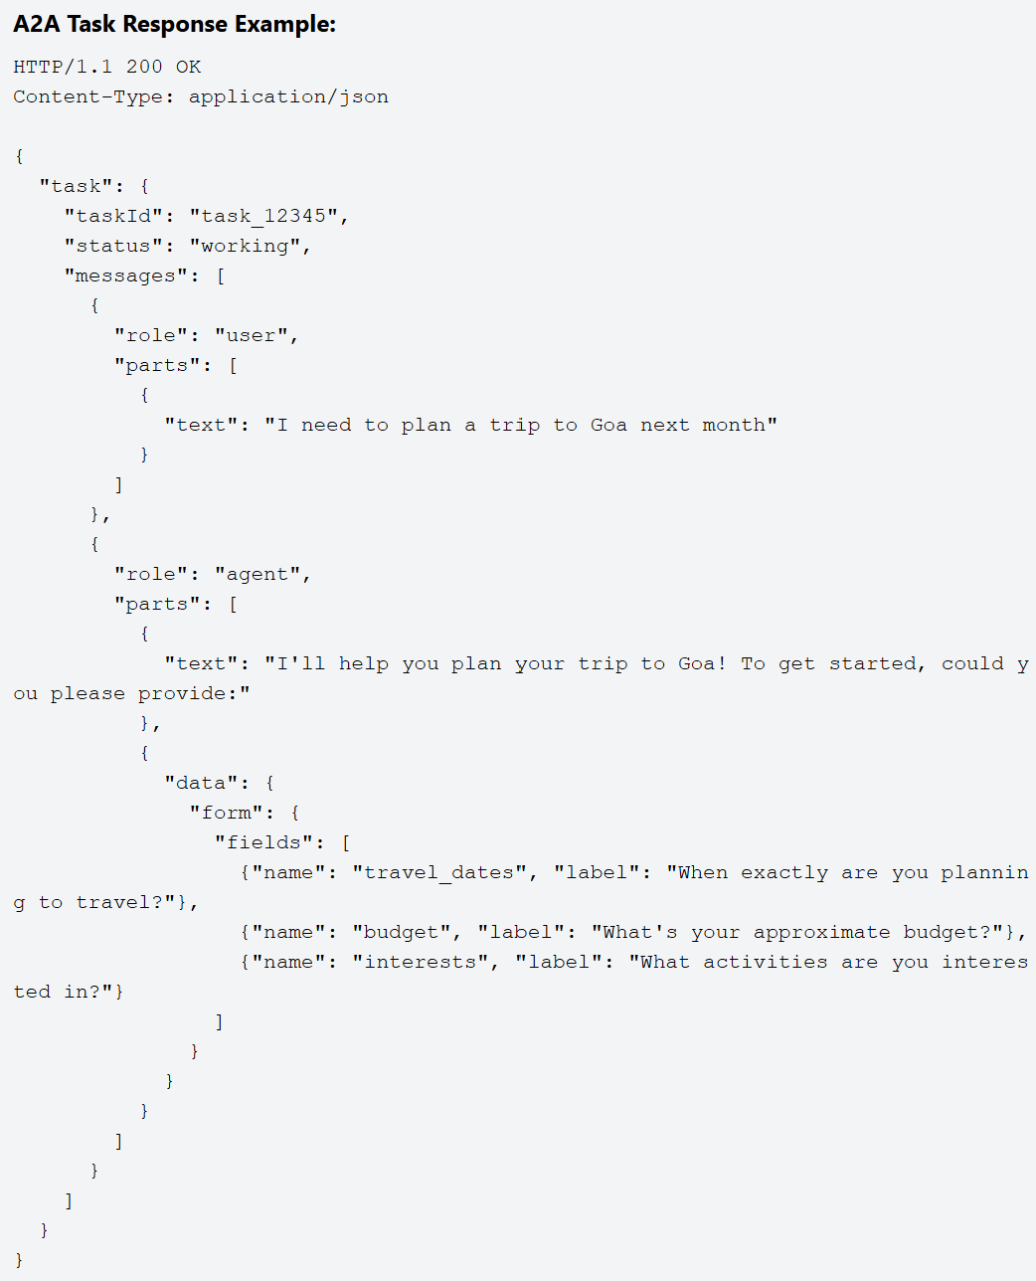
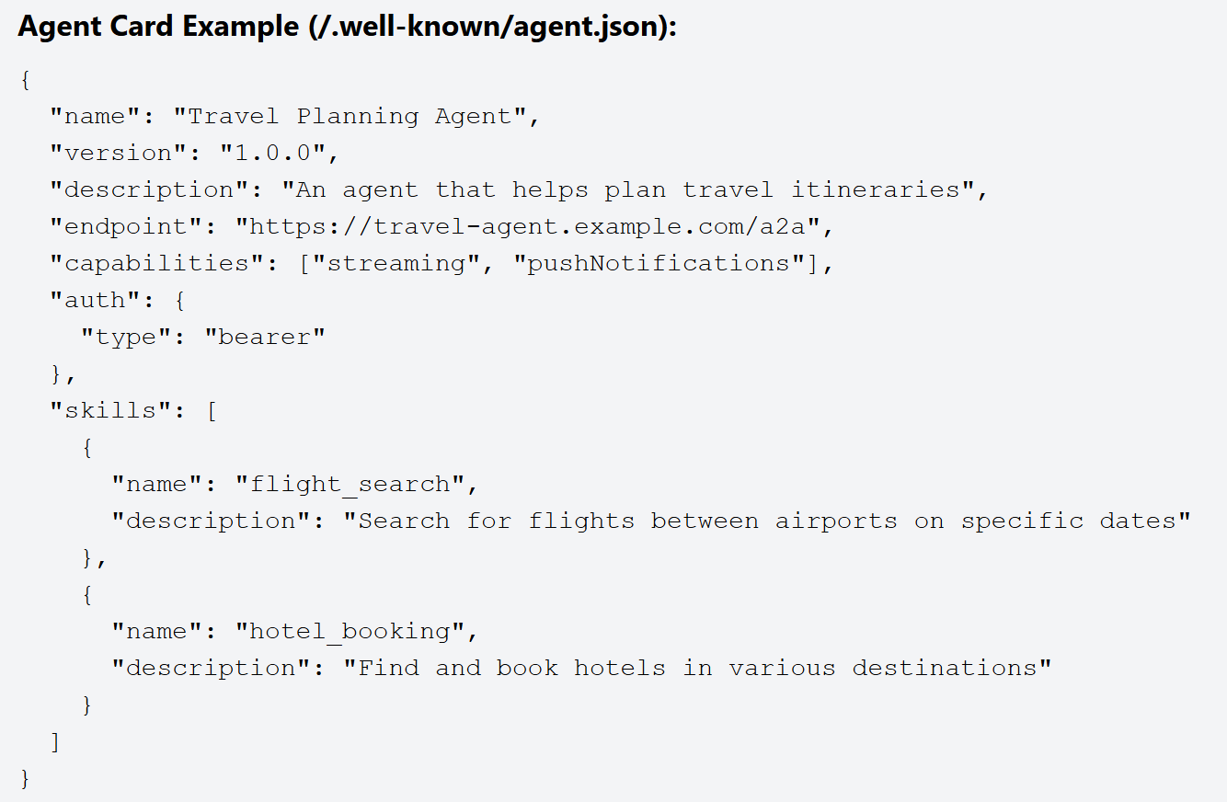
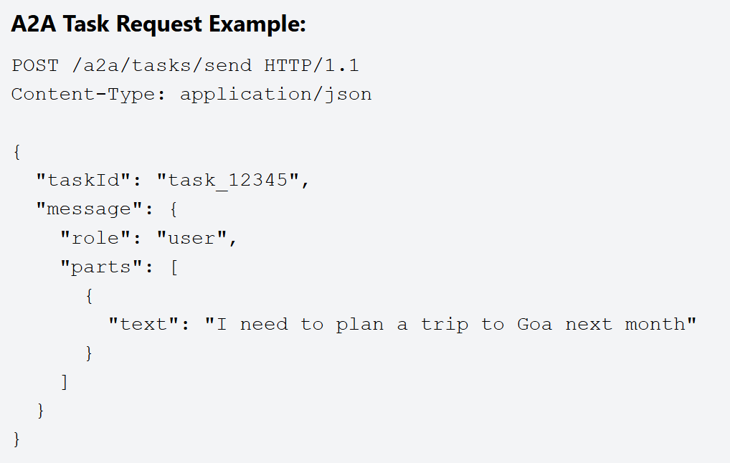
A2A: Technical Implementation
The technical implementation of A2A involves several key components that work together to enable seamless agent communication:

Slide 17
A2A: Real-World Applications
Intelligent Anti-Money Laundering (AML) Transaction Monitoring & Case Management
Scenario: A bank processes millions of transactions daily, and a portion of these may represent potential money laundering activities that need to be identified, investigated, and reported.
Agent to Agent Protocol for: Automating the detection, investigation, and reporting of suspicious financial activities, integrating various data sources and analytical capabilities.
Application:
Multi-Agent System (MAS) Components:
Transaction Monitoring Agent: Analyzes real-time transaction streams for suspicious patterns.
Customer Due Diligence (CDD) Agent: Manages and provides customer risk profiles and KYC data.
External Data Agent: Interfaces with external sanctions lists, adverse media databases, etc.
Network Analysis Agent: Identifies hidden relationships between entities.
Case Management Agent: Creates, assigns, and tracks suspicious activity investigations.
Regulatory Reporting Agent: Formats and submits required reports to authorities.
Compliance Officer Agent (Human Interface): Facilitates human review and final decision-making.
Benefit:
Enhanced Detection Accuracy: Integrates multiple data points and analytical techniques to improve the identification of genuine money laundering activities.
Faster Investigation Cycles: Automates data gathering and initial analysis, reducing the time and effort for human investigators.
Improved Compliance: Ensures timely and accurate reporting to regulatory authorities.
Reduced Manual Burden: Frees up compliance officers to focus on complex cases requiring human judgment.
Proactive Risk Mitigation: Identifies and acts on suspicious patterns before they escalate into significant financial crime.
Dynamic Treasury Management & Liquidity Optimization
Scenario: A bank needs to manage its internal liquidity, optimize cash flows across various accounts and currencies, and fulfill regulatory reserve requirements in real-time.
Agent to Agent Protocol for: Automated and intelligent management of a bank's treasury operations, including cash positioning, funding, and investment.
Application:
Multi-Agent System (MAS) Components:
Cash Position Agent: Tracks real-time balances across all internal and external accounts.
Funding Agent: Identifies funding needs or surpluses.
Investment Agent: Seeks short-term investment opportunities for surplus cash.
Borrowing Agent: Identifies borrowing opportunities when liquidity is tight.
Regulatory Reserve Agent: Monitors compliance with central bank reserve requirements.
Risk Management Agent: Assesses financial risks (interest rate, FX, credit).
Forecasting Agent: Predicts future cash flows.
Benefit:
Optimized Liquidity: Ensures the bank always has sufficient funds while minimizing idle cash, improving capital efficiency.
Reduced Funding Costs: Automatically identifies the cheapest sources of funds and the best investment opportunities.
Enhanced Compliance: Real-time monitoring and adjustment ensure adherence to central bank reserve requirements.
Improved Risk Management: Proactive identification and mitigation of liquidity and market risks.
24/7 Operations: Automated agents can operate continuously, reacting to market changes and internal needs outside of human working hours.
Notes:
Dynamic Treasury Management & Liquidity Optimization
Scenario: A bank needs to manage its internal liquidity, optimize cash flows across various accounts and currencies, and fulfill regulatory reserve requirements in real-time.
Agent to Agent Protocol for: Automated and intelligent management of a bank's treasury operations, including cash positioning, funding, and investment.
Application:
Multi-Agent System (MAS) Components:
Cash Position Agent: Tracks real-time balances across all internal and external accounts.
Funding Agent: Identifies funding needs or surpluses.
Investment Agent: Seeks short-term investment opportunities for surplus cash.
Borrowing Agent: Identifies borrowing opportunities when liquidity is tight.
Regulatory Reserve Agent: Monitors compliance with central bank reserve requirements.
Risk Management Agent: Assesses financial risks (interest rate, FX, credit).
Forecasting Agent: Predicts future cash flows.
Benefit:
Optimized Liquidity: Ensures the bank always has sufficient funds while minimizing idle cash, improving capital efficiency.
Reduced Funding Costs: Automatically identifies the cheapest sources of funds and the best investment opportunities.
Enhanced Compliance: Real-time monitoring and adjustment ensure adherence to central bank reserve requirements.
Improved Risk Management: Proactive identification and mitigation of liquidity and market risks.
24/7 Operations: Automated agents can operate continuously, reacting to market changes and internal needs outside of human working hours.

Slide 18
A2A: Advantages and Limitations
Advantages
Framework-agnostic: Works across different AI frameworks and platforms
Rich communication: Supports text, forms, files, audio/video, and structured data
Enterprise-ready: Secure, cross-organizational collaboration with authentication
Capability discovery: Agents can advertise their abilities through Agent Cards
Real-time updates: Streaming support for complex, long-running tasks
Standardized protocol: Consistent implementation across different systems
Limitations
Complex implementation: More involved setup compared to simpler protocols
Nascent ecosystem: Still early in adoption cycle with evolving standards
Higher overhead: Requires more infrastructure and computational resources
Coordination challenges: Managing complex multi-agent workflows
Security considerations: Requires careful implementation of authentication

Slide 19
What This Means for Developers
So, what should you, as a developer building with AI, do with these competing standards?
For simple applications: Function Calling remains the quickest path to adding tool use to your LLM application, especially if you're only using one model provider.
For cross-model compatibility: Consider adopting MCP, which gives you broader model support without duplicating integration work.
For complex multi-agent systems: Keep an eye on A2A, which could become crucial as agent ecosystems mature.
The smart play might be to layer these approaches: use Function Calling for quick prototyping, but implement MCP adapters for better scalability, with A2A orchestration for multi-agent workflows.

Slide 20
The Road Ahead
The conversation around what makes an "AI Agent" is still evolving — sometimes even debated between companies like OpenAI, Anthropic, and LangChain.
But regardless of definitions, one thing is clear: Standards like Function Calling, MCP, and A2A are laying the foundation for the next generation of AI applications.
For developers, understanding these patterns early is an investment in future-proofing your work. The agent ecosystem is developing rapidly, and building on these protocols now means positioning your applications for what's coming next.

Slide 21
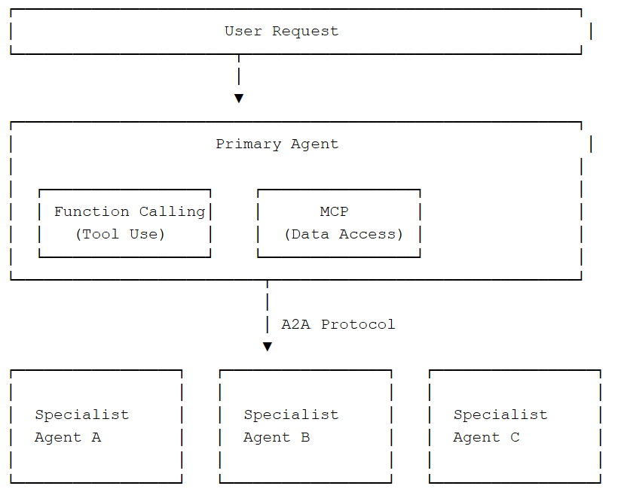
How They Work Together
These three technologies are complementary rather than competitive - they don't replace each other but instead work together. In fact, a sophisticated AI system might leverage all three protocols simultaneously to achieve maximum capability:
Function Calling provides the basic mechanics for a single agent to use tools and APIs, forming the foundation of AI capability
MCP standardizes how agents access external data sources, enabling consistent information retrieval across different repositories
A2A enables those agents to communicate with other specialized agents, creating collaborative networks of AI systems
Example Integration
The Future of AI Integration
As these protocols continue to mature and gain wider adoption, we're witnessing the emergence of a new paradigm in AI system design. Rather than monolithic models trying to do everything, we're moving toward ecosystems of specialized AI agents that can seamlessly work together through standardized protocols.
This shift mirrors how human organizations work - with specialists in different domains collaborating to solve complex problems. The combination of Function Calling, MCP, and A2A creates the foundation for truly capable AI systems that can understand user needs, access relevant information, and coordinate specialized expertise to deliver comprehensive solutions.

Slide 22
Real-World Examples
Function Calling Example
Meeting Scheduler
User asks:
"Schedule a meeting with the marketing team next Tuesday at 2 PM about the new campaign.“
AI identifies:
Need to create calendar event
Calls create_meeting function
Passes attendees, time, topic details
AI responds:
"I've scheduled a meeting with the marketing team for Tuesday, May 3rd at 2:00 PM titled 'New Campaign Discussion'. Calendar invites have been sent to all team members.“
MCP Example
Code Assistant
User asks:
"Can you help me understand how the authentication system works in our codebase? I'm specifically looking for how password reset is handled.“
AI uses MCP to:
Connect to GitHub via MCP server
Search repository for auth code
Access password reset implementation
Read documentation and tests
AI responds:
"I've analyzed your codebase. The password reset workflow is implemented in `auth/password_reset.py`. It uses a token-based system with a 24-hour expiry. Here's how it works: [detailed explanation with code references]"
A2A Example
Travel Planning System
User asks:
"I want to plan a 5-day trip to Kerala next month for my anniversary. We love nature and good food. Budget is around ₹50,000.“
Multi-agent collaboration:
Primary agent uses A2A to connect to:
Travel Agent (flight/hotel options)
Local Expert Agent (Kerala activities)
Budget Manager Agent (cost optimization)
Agents coordinate via A2A protocol
Coordinated response:
"I've created a complete Kerala itinerary for your anniversary with flights from Delhi (₹12,000), boutique eco-resort in Munnar (₹20,000), guided nature walks, authentic Kerala cuisine experiences, and a romantic backwater cruise - all within your ₹50,000 budget. Would you like to see the day-by-day plan?"

Slide 23
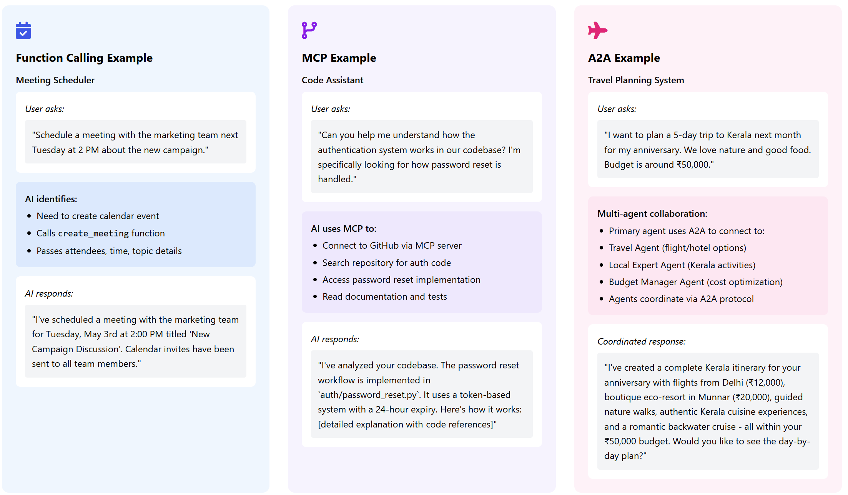
Real-World Examples

Slide 24
Advanced Example Use Case - Integrating All Three
Enterprise Knowledge Assistant
Executive asks:
"I need a comprehensive analysis of our Q1 sales performance compared to projections, with recommendations for Q2 strategy. Include relevant market trends and competitor analysis. Schedule a meeting with the sales directors to review your findings."
Function Calling Role:
Creates meeting invitation
Generates PDF report
Sends notifications
MCP Role:
Accesses sales data from Salesforce
Retrieves forecasts from internal systems
Searches meeting records for context
A2A Role:
Engages Data Analyst Agent for trends
Consults Strategy Agent for recommendations
Coordinates with Scheduling Agent
Integrated response:
"I've prepared a comprehensive Q1 sales analysis showing we exceeded targets in enterprise sales (112%) but underperformed in SMB sector (85%). Based on market analysis and competitor data, I've outlined three strategic recommendations for Q2.
A meeting is scheduled with all sales directors for Thursday at 10 AM, and I've attached the full report to the invitation. Would you like me to highlight any specific sections during the meeting?“
Q1_Sales_Analysis_Report.pdf

Slide 25
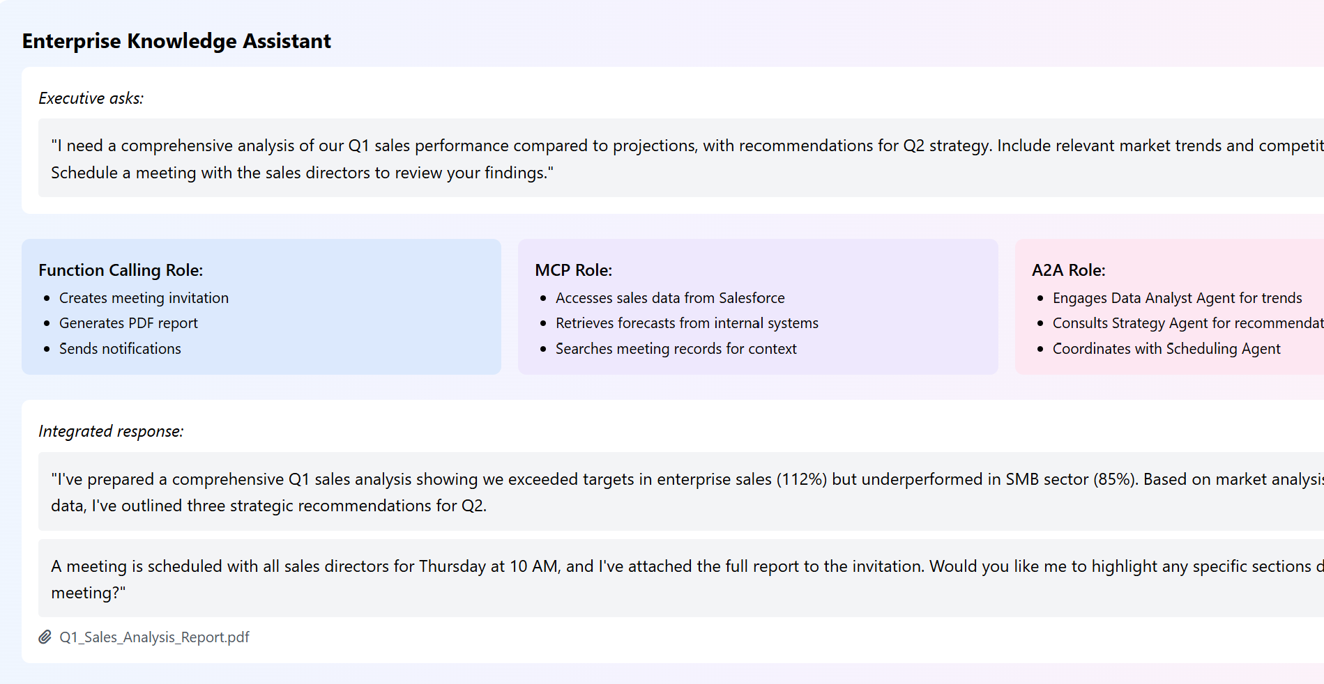
Advanced Example Use Case - Integrating All Three

Slide 26
References
[2504.16736] A Survey of AI Agent Protocols
AI Protocol Guide - a Hugging Face Space by Abhaykoul
Function Calling vs. MCP vs. A2A: Developer’s Guide to AI Agent Protocols - Zilliz blog
MCP, A2A, ACP: What does it all mean?

